Slide 1
Coordination Briefing Türkiye Earthquakes
6 March 2023

Slide 2
Operational key insights
CVA: The 10,000 TL Per Household Support payment for citizens affected by the earthquake was transferred to the accounts of 1,025,204 earthquake survivor families. Erdogan stated on 2 March that the government will start to pay 15 thousand liras as relocation aid to earthquake victims who will move their houses [1].
SHELTER: AFAD reports that 1,593,808 people have been given shelter within earthquake affected provinces, and 329,960 people have been given shelter in other provinces throughout Türkiye. More details are provided on slides 4-6 [2].
Notes:
[1] https://reliefweb.int/report/turkiye/president-erdogan-we-are-starting-pay-15-thousand-liras-relocation-aid-earthquake-survivors-today
[2] https://www.afad.gov.tr/kahramanmaras-merkezli-yurutulen-calismalar-hakkinda--basin-bulteni--37

Slide 3
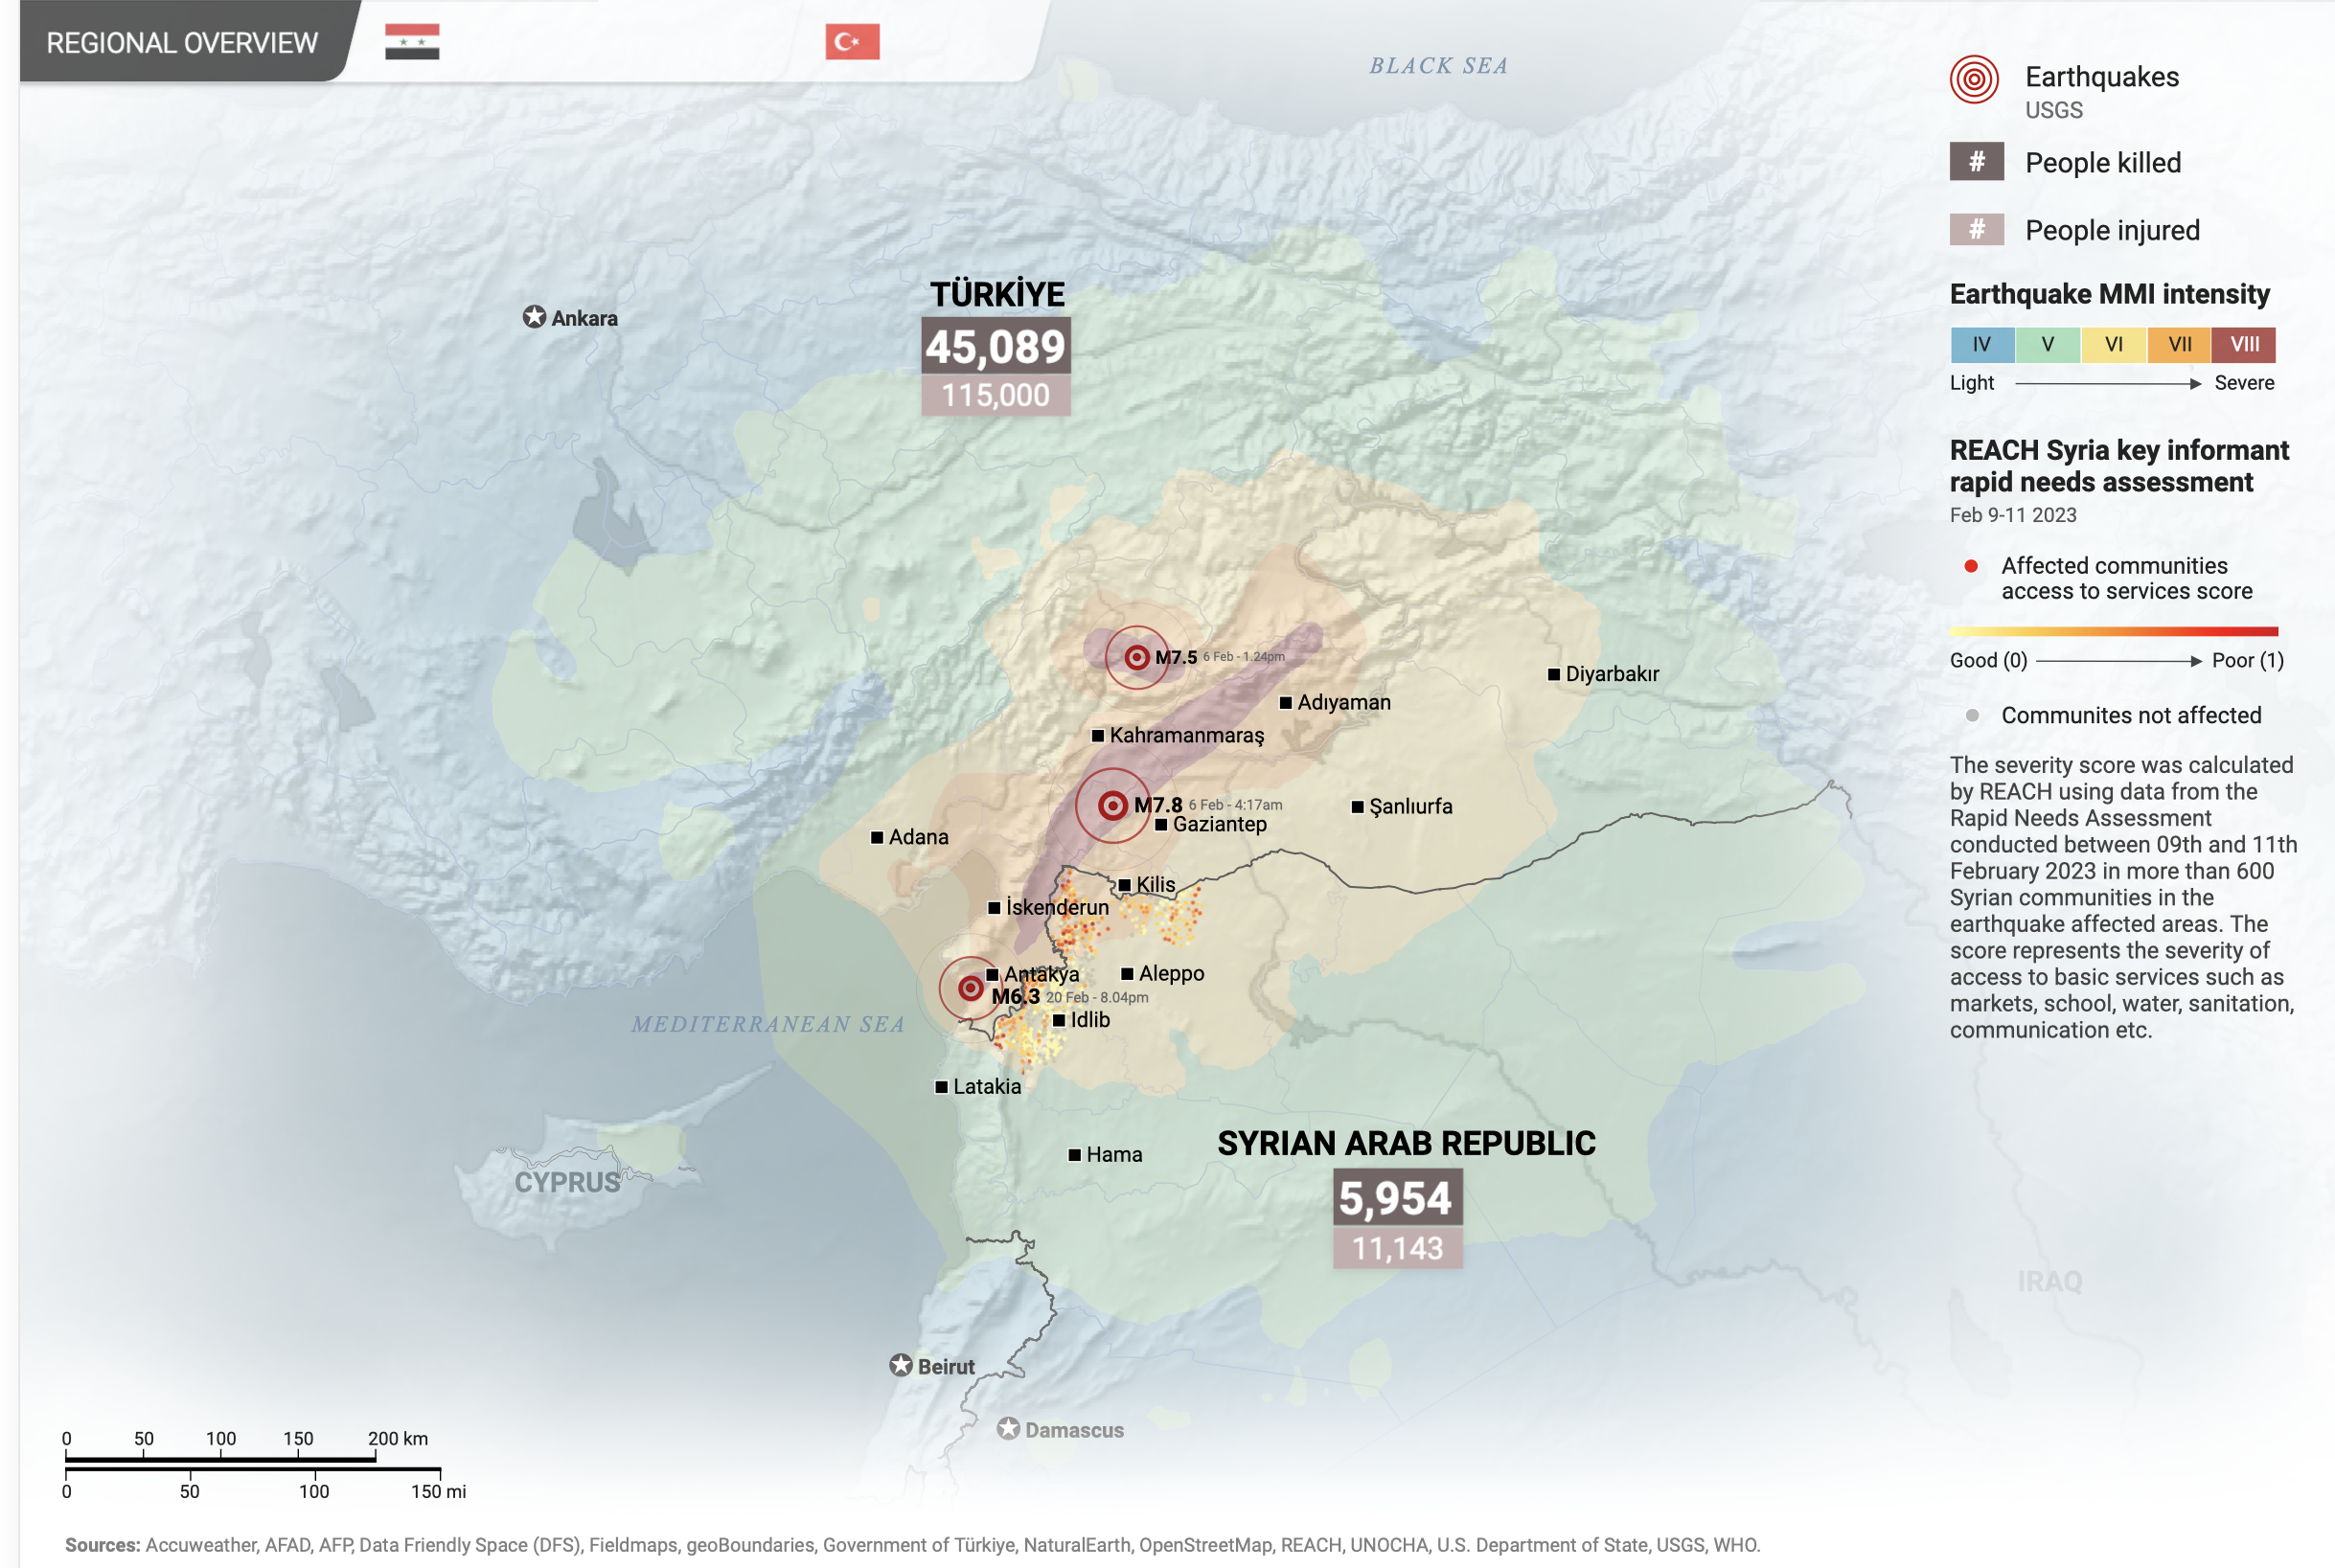
Latest key figures, as of 6 March
CASUALTIES
45,089
AFAD [1]
BUILDINGS HEAVILY DAMAGED
195,400
Government of Türkiye Damage Assessment [2]
PEOPLE DIRECTLY AFFECTED
9,100,000
UNOCHA [3]
PEOPLE EVACUATED
1,971,589
AFAD [1]
=Number higher than previous day’s report
=Number the same as previous day/ data source not updated
=Number lower than previously reported
Notes:
[1] https://ifrcorg.sharepoint.com/sites/TurkiyeEQEA-JointFolderTRCIFRC/Shared%20Documents/Forms/AllItems.aspx?ga=1&id=%2Fsites%2FTurkiyeEQEA%2DJointFolderTRCIFRC%2FShared%20Documents%2FInformation%20Management%2FInfographics%2F3W%2FData%20sources%2FV40%5FTürkiye%20Pazarcık%20Earthquake%5FKM%2Epdf&viewid=88a9ad66%2Db9f2%2D42af%2D947d%2Db19d2f9b59fb&parent=%2Fsites%2FTurkiyeEQEA%2DJointFolderTRCIFRC%2FShared%20Documents%2FInformation%20Management%2FInfographics%2F3W%2FData%20sources . Number evacuated is described by AFAD as: “The total number of people who registered from Kahramanmaraş, Gaziantep, Şanlıurfa, Diyarbakır, Adana, Adıyaman, Osmaniye, Hatay, Kilis, Malatya and Elazığ by applying to the governorships and district governorships in the provinces where they were evacuated by the Gendarmerie General Command and their own means”. [2] https://turkiyeeq.thedeep.io ACU, Government of Türkiye, UNDP, UNOCHA
[3] https://reliefweb.int/report/turkiye/turkiye-2023-earthquakes-situation-report-no-5-27-february-2023

Slide 4
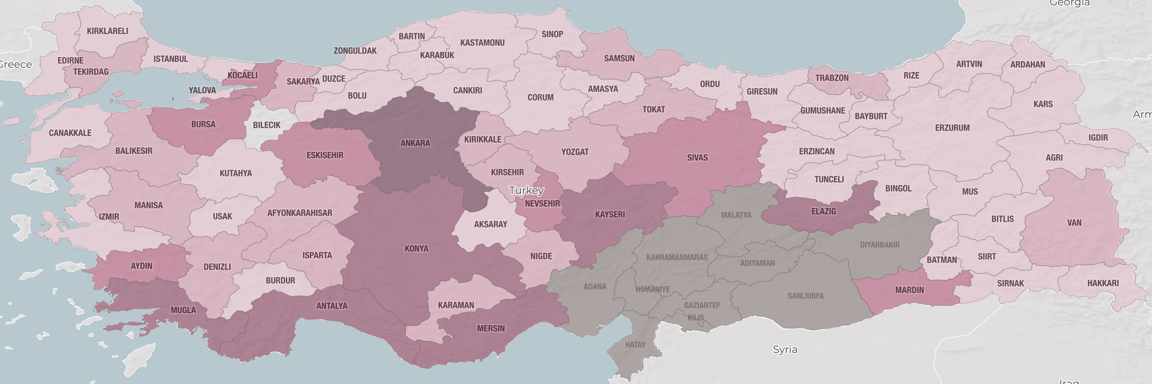
Displacement outside of earthquake-affected provinces
More than 1.1 million people (mostly Turkish citizens) have evacuated from the provinces most affected by the earthquakes and registered with the governorships and district governships of different Turkish provinces [1]. OCHA reports this figure as 1.9 million [2].
Estimated number of people who have moved to different provinces of Türkiye
Legend
Heavily-affected provinces*
154,861 – 205,454
No data on population movement
28,037 – 154,860
Data source is official numbers reported by governorates of each province, and reported in the IOM displacement report [2], and updated as of 1 March.
* Elazig is also considered a heavily-affected province but it is accepting thousands of people fleeing the provinces to the south.
17,401– 28,036
7,323– 17,400
0 – 7,322
Notes:
[1] https://ifrcorg-my.sharepoint.com/personal/sheltersectorim1_turkiye_ifrc_org/_layouts/15/onedrive.aspx?id=%2Fpersonal%2Fsheltersectorim1%5Fturkiye%5Fifrc%5Forg%2FDocuments%2FMicrosoft%20Teams%20Chat%20Files%2F2023%20Earthquakes%20Displacement%20Overviews%2Epdf&parent=%2Fpersonal%2Fsheltersectorim1%5Fturkiye%5Fifrc%5Forg%2FDocuments%2FMicrosoft%20Teams%20Chat%20Files&or=teams&ga=1
[2] https://reliefweb.int/report/turkiye/turkiye-2023-earthquakes-situation-report-no-6-3-march-2023
[3] https://www.afad.gov.tr/kahramanmaras-merkezli-yurutulen-calismalar-hakkinda--basin-bulteni--37

Slide 5
Displacement within earthquake-affected provinces
TOTAL ESTIMATED DISPLACED WITHIN EARTHQUAKE-AFFECTED PROVINCES
2,700,000
IOM [2]
774,483 (58%)
489,149 (45%)
320,100 (45%)
307,204 (67%)
252,317 (23%)
98,913 (5%)
69,442 (23%)
58,895 (12%)
52,779 (12%)
28,090 (5%)
13,750 (7%)
Notes:
[1] https://reliefweb.int/report/turkiye/turkiye-2023-earthquakes-situation-report-no-6-3-march-2023
[2] https://ifrcorg-my.sharepoint.com/personal/sheltersectorim1_turkiye_ifrc_org/_layouts/15/onedrive.aspx?id=%2Fpersonal%2Fsheltersectorim1%5Fturkiye%5Fifrc%5Forg%2FDocuments%2FMicrosoft%20Teams%20Chat%20Files%2F2023%20Earthquakes%20Displacement%20Overviews%2Epdf&parent=%2Fpersonal%2Fsheltersectorim1%5Fturkiye%5Fifrc%5Forg%2FDocuments%2FMicrosoft%20Teams%20Chat%20Files&or=teams&ga=1

Slide 6
Sheltering of displaced people within earthquake-affected provinces
332 TENT CITIES [1]
NUMBER OF TENTS
360,167
NUMBER OF PEOPLE IN TENTS (WITHIN TENT CITIES)
1,440,668
189 CONTAINER CITIES [1]
NUMBER OF CONTAINERS
6,698*
NUMBER OF PEOPLE IN CONTAINERS (WITHIN CONTAINER CITIES)
34,120
* AFAD reports that the infrastructure work and installation of 90,914 containers continues [1].
Notes:
[1] https://www.afad.gov.tr/kahramanmaras-merkezli-yurutulen-calismalar-hakkinda--basin-bulteni--37
[2] https://ifrcorg-my.sharepoint.com/personal/sheltersectorim1_turkiye_ifrc_org/_layouts/15/onedrive.aspx?id=%2Fpersonal%2Fsheltersectorim1%5Fturkiye%5Fifrc%5Forg%2FDocuments%2FMicrosoft%20Teams%20Chat%20Files%2F2023%20Earthquakes%20Displacement%20Overviews%2Epdf&parent=%2Fpersonal%2Fsheltersectorim1%5Fturkiye%5Fifrc%5Forg%2FDocuments%2FMicrosoft%20Teams%20Chat%20Files&or=teams&ga=1

Slide 7
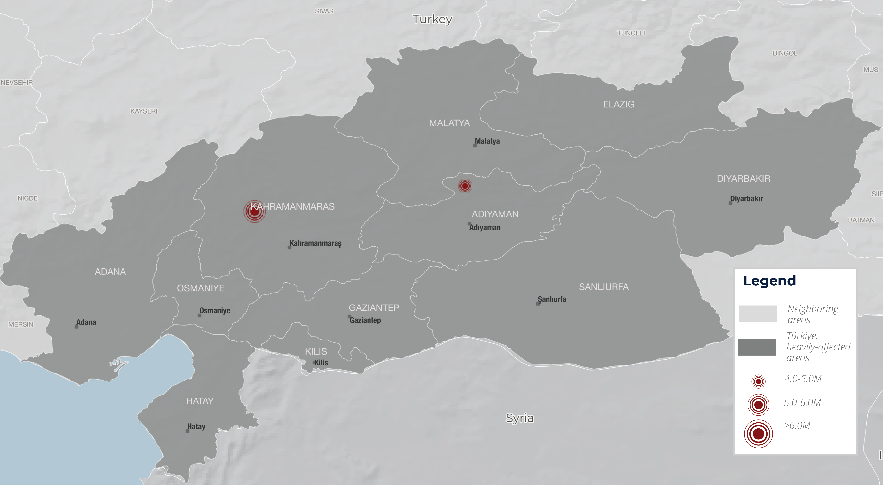
Aftershocks M> 4.0 on 2-6 March
Significant aftershocks (M >4.0) recorded by USGS in the 11 provinces affected by the 6 February M 7.8 earthquake
Aftershock Sequence Scenarios [1]
Although the 20 Feb. 6.3 earthquake in Hatay was the largest since the 6 Feb. quakes, we are still in UGSG’s “most likely scenario”:
Most likely (>90%): Aftershocks will continue to decrease in frequency, with no aftershocks larger than M7 within the next month. Moderate to large aftershocks (M5 and M6) are likely.
1
Less likely (~10%): One or more additional aftershocks larger than M7, but with none larger than the M7.8 mainshock. Would temporarily re-energize the aftershock sequence.
2
Least likely (~1%): The sequence could generate an aftershock of the same size or even larger than the M7.8 mainshock. Would likely trigger an aftershock sequence of its own.
3
Notes:
[1] USGS

Slide 8
Frequency of aftershocks since 6 Feb.
There have been over 10,000 aftershocks since the earthquakes on 6 Feb. Dots shown here represent only those above 4.0M [1]. While moderate to large (5.0-6.0M) earthquakes are still possible, the frequency of aftershocks appears to be slowing down, further evidence of USGS’s “most likely” scenario. However, aftershocks may continue for years to come. Following the 2017 Bodrum earthquake for example, over 9,000 aftershocks were recorded in one year [2].
Notes:
[1] USGS
[2] https://www.hurriyetdailynews.com/10-provinces-experienced-cosmic-disaster-experts-180699

Slide 9
TRC distributions over time
HOT MEALS DISTRIBUTED
102,285,000
Cumulative, Turkish Red Crescent
BLANKETS DISTRIBUTED
202,026
Cumulative, Turkish Red Crescent
TENTS DISPATCHED
70,611
Cumulative, Turkish Red Crescent
Additional key TRC humanitarian relief activities
TRC’S VOUCHER PROGRAM began on 22 February. More than 140,000 cards will be distributed to earthquake-affected households to cover their most immediate needs.
MOBILE HEALTH UNITS are operational. TRC and IFRC—in support of the Ministry of Health—will establish a total of 12 mobile health clinics. Six of them are already running to support rural communities and collective shelter sites with health interventions.
Notes:
https://ifrcorg.sharepoint.com/:x:/r/sites/TurkiyeEQEA-JointFolderTRCIFRC/_layouts/15/Doc.aspx?sourcedoc=%7BE2549B8F-07E4-413F-8E7C-70BCAE406B3B%7D&file=trc_data.xlsx&action=default&mobileredirect=true&cid=b52e3be5-e30e-47b5-82e6-659425ddde3d

Slide 10
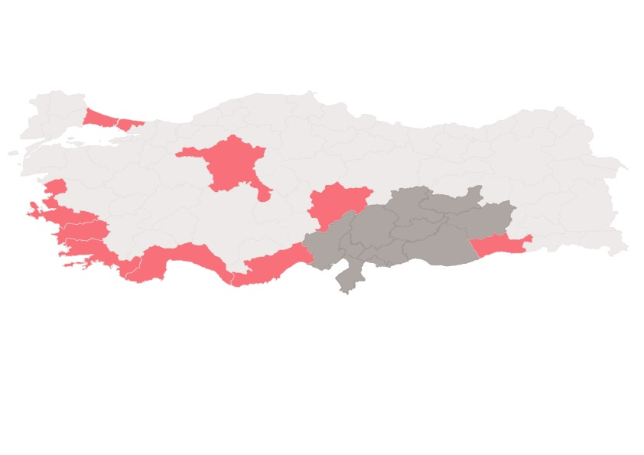
Updated: 5 March 2023
Turkish Red Crescent Response
Earthquake | Türkiye
Turkish Red Crescent (TRC) is actively responding to the devastating earthquakes that took place on 6 February. Humanitarian relief activities are taking place in the provinces most affected by the earthquakes.
Situation Overview
TRC response, as of 3 March
LEGEND
PERSONNEL/VOLUNTEERS
4,631
HEAVILY-AFFECTED PROVINCE
FEBRUARY 6 EARTHQUAKES
ASSESSMENTS
PSYCHOSOCIAL SUPPORT (PSS) TENTS
MOBILE PSS FOR CHILDREN
FOOD DISTRIBUTIONS
CHILD-FRIENDLY SPACE
DEATHS
45,089
RESPONSE VEHICLES
883
MALATYA
ELEZIG
DISTRIBUTION POINTS
1,000
DIYARBAKIR
INJURED
108,272
KAHRAMANMARAS
ADIYAMAN
ADANA
OSMANIYE
SANLIURFA
DISPLACED
1,971,589
GAZIANTEP
KILIS
HATAY
AFFECTED
9,100,000
Population movement
Extent of TRC reach
PROVINCES HEAVILY IMPACTED
11
HOT MEALS
100,285,000
HEATERS
33,353
PSS
47,374
HOUSEHOLD UNITS DAMAGED
3,273,605
BOTTLED WATER
41,600,000
HYGIENE KITS
67,700
HEALTH CARE
12,257
ESTIMATED EARTHQUAKE- AFFECTED PEOPLE REACHED BY TRC
1,285,000
ITEMS DISTRIBUTED
SERVICES PROVIDED
BLOOD DONATION POINTS
300
Displacement models follow the well-established northwestern movement of migration that existed in Turkey prior to the earthquake. Large cities as well as coastal provinces are seeing a large population influx.
TENTS
70,611
BLANKETS
202,026
Product created by SIMS. Data sources: Turkish Red Crescent, AFAD, IOM.
Notes:
https://ifrcorg.sharepoint.com/:x:/r/sites/TurkiyeEQEA-JointFolderTRCIFRC/_layouts/15/Doc.aspx?sourcedoc=%7BE2549B8F-07E4-413F-8E7C-70BCAE406B3B%7D&file=trc_data.xlsx&action=default&mobileredirect=true&cid=b52e3be5-e30e-47b5-82e6-659425ddde3d

