Slide 1
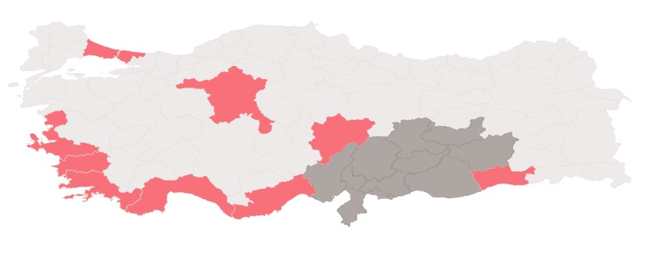
Updated: 5 March 2023
Turkish Red Crescent Response
Earthquake | Türkiye
Turkish Red Crescent (TRC) is actively responding to the devastating earthquakes that took place on 6 February. Humanitarian relief activities are taking place in the provinces most affected by the earthquakes.
TRC response, as of 5 March
LEGEND
Situation Overview
PERSONNEL/VOLUNTEERS
4,631
HEAVILY-AFFECTED PROVINCE
FEBRUARY 6 EARTHQUAKES
ASSESSMENTS
PSYCHOSOCIAL SUPPORT (PSS) TENTS
MOBILE PSS FOR CHILDREN
FOOD DISTRIBUTIONS
CHILD-FRIENDLY SPACE
RESPONSE VEHICLES
883
DEATHS
45,089
DISTRIBUTION POINTS
1,000
MALATYA
ELEZIG
INJURED
108,272
KAHRAMANMARAS
DIYARBAKIR
ADIYAMAN
ADANA
OSMANIYE
SANLIURFA
GAZIANTEP
DISPLACED
1,971,589
KILIS
HATAY
AFFECTED
9,100,000
Population movement
Extent of TRC reach
PROVINCES HEAVILY IMPACTED
11
ESTIMATED EARTHQUAKE-AFFECTED PEOPLE REACHED BY TRC
1,285,000
HOT MEALS
100,285,000
HEATERS
33,353
PSS
47,374
HOUSEHOLD UNITS DAMAGED
3,273,605
BOTTLED WATER
41,600,000
HYGIENE KITS
67,700
HEALTH CARE
12,257
Displacement models follow the well-established northwestern movement of migration that existed in Turkey prior to the earthquake. Large cities as well as coastal provinces are seeing a large population influx.
ITEMS DISTRIBUTED
SERVICES PROVIDED
TENTS
70,611
BLANKETS
202,026
BLOOD DONATION POINTS
300
Product created by SIMS. Data sources: Turkish Red Crescent, AFAD, IOM.

